Slide 1
Chapter 7
Memory Management

Slide 2
Memory Management
Frame | A fixed-length block of main memory.
Page | A fixed-length block of data that resides in secondary memory (such as disk). A page of data may temporarily be copied into a frame of main memory.
Segment | A variable-length block of data that resides in secondary memory. An entire segment may temporarily be copied into an available region of main memory (segmentation) or the segment may be divided into pages which can be individually copied into main memory (combined segmentation and paging).

Slide 3
Memory Management
Subdividing memory to accommodate multiple processes (multiprogramming system)
Memory needs to be allocated to ensure a reasonable supply of ready processes to consume available processor time
If only a few processes are in memory and most of the time waiting for I/O → processor will be idle

Slide 4
Memory Management
Requirements to satisfy
Relocation
Protection
Sharing
Logical organization
Physical organization

Slide 5
Memory Management Requirements
Relocation
Programmer does not know where the program will be placed in memory when it is executed
While the program is executing, it may be swapped to disk and returned to main memory at a different location (relocated) – maximize processor utilization
Memory references in the code must be translated to actual physical memory address (by hardware and OS)

Slide 6
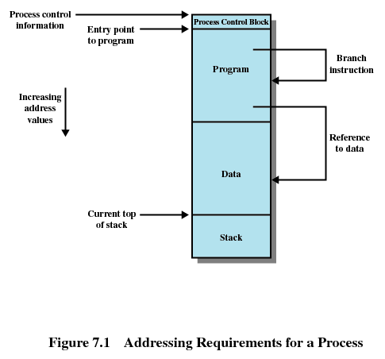
Memory Management Requirements

Slide 7
Memory Management Requirements
Protection
Processes need to acquire permission to reference memory locations for reading or writing purposes
Location of a program in main memory is unpredictable – impossible to check absolute addresses at compile time
Memory references generated by a process must be checked at run time
Protection must be supported by processor

Slide 8
Memory Management Requirements
Protection
Processes need to acquire permission to reference memory locations for reading or writing purposes
Location of a program in main memory is unpredictable – impossible to check absolute addresses at compile time
Memory references generated by a process must be checked at run time
Protection must be supported by processor

Slide 9
Memory Management Requirements
Sharing
Allow each process access to the same copy of the program rather than have their own separate copy
Allow controlled access to shared areas of memory without compromising protection. Example, processes access to the same data structure

Slide 10
Memory Management Requirements
Logical Organization
Memory (main and secondary) is organized as linear address space, programs are written in modules

Slide 11
Memory Management Requirements
Logical Organization
Advantages if OS and hardware can effectively deal with programs and data in modules:
Modules can be written and compiled independently, references from one module to another resolved by the system at run time
Different degrees of protection given to modules (read-only, execute-only)
Share modules among processes
Tool that most readily satisfies requirements

Slide 12
Memory Management Requirements
Physical Organization
Information move between main memory and secondary memory → responsibility of OS, not the programmer, reasons:
Memory available for a program plus its data may be insufficient
Overlaying allows various modules to be assigned the same region of memory – waste programmer time.
Programmer does not know how much space will be available

Slide 13
Memory Partitioning
Memory management brings processes into main memory for execution by the processor
involves virtual memory (based on segmentation and paging)
Partitioning
used in several variations in some now-obsolete operating systems
does not involve virtual memory

Slide 14
Memory Partitioning: Fixed Partitioning
Equal-size partitions
Any process whose size is less than or equal to the partition size can be loaded into an available partition
If all partitions are full, the operating system can swap a process out of a partition
A program may not fit in a partition. The programmer must design the program with overlays

Slide 15
Memory Partitioning: Fixed Partitioning
Equal-size partitions
Main memory use is inefficient. Any program, regardless of size, occupies an entire partition.
wasted space due to the block of data loaded being smaller than the partition – internal fragmentation.
The problems can be lessened by using unequal-size partitions

Slide 16
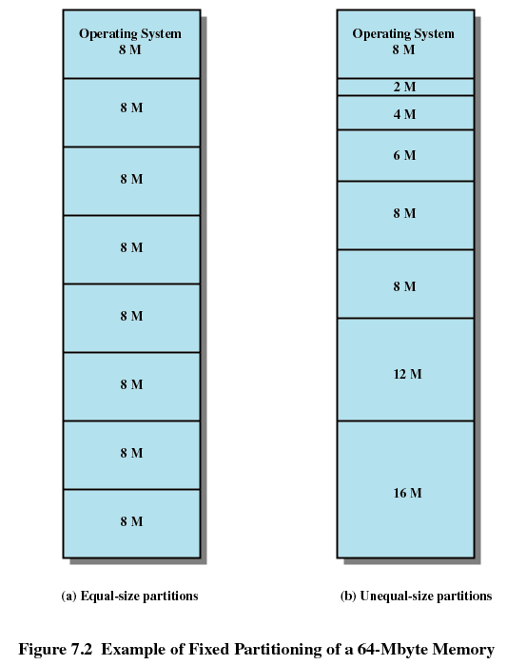
Memory Partitioning: Fixed Partitioning

Slide 17
Dynamic Partitioning
Partitions are of variable length and number
Process is allocated exactly as much memory as required
Used by IBM’s mainframe operating system, OS/MVT

Slide 18
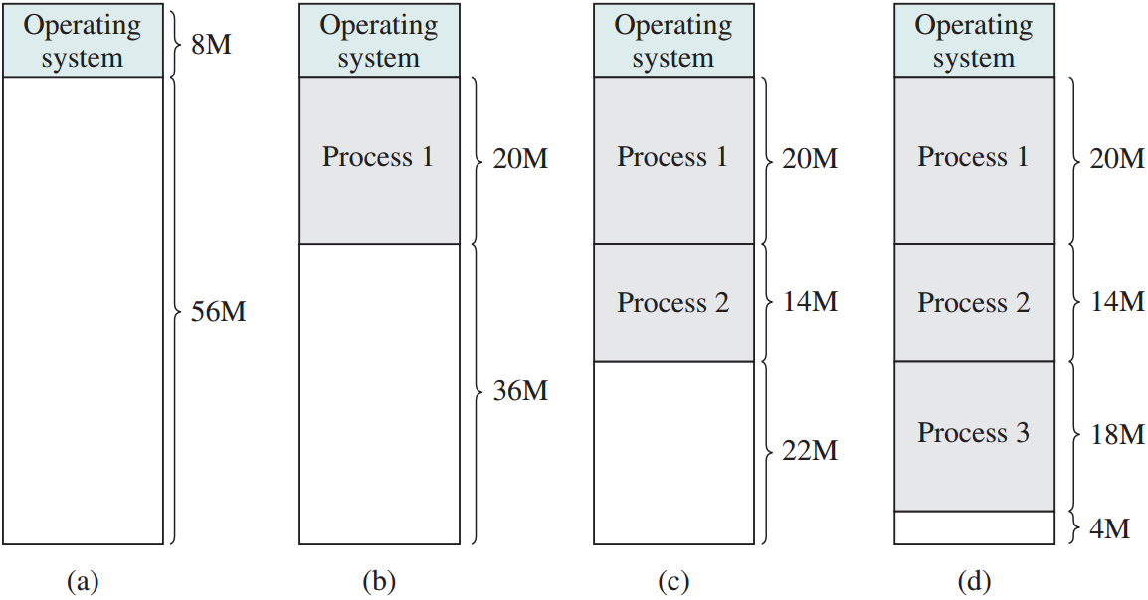
Dynamic Partitioning

Slide 19
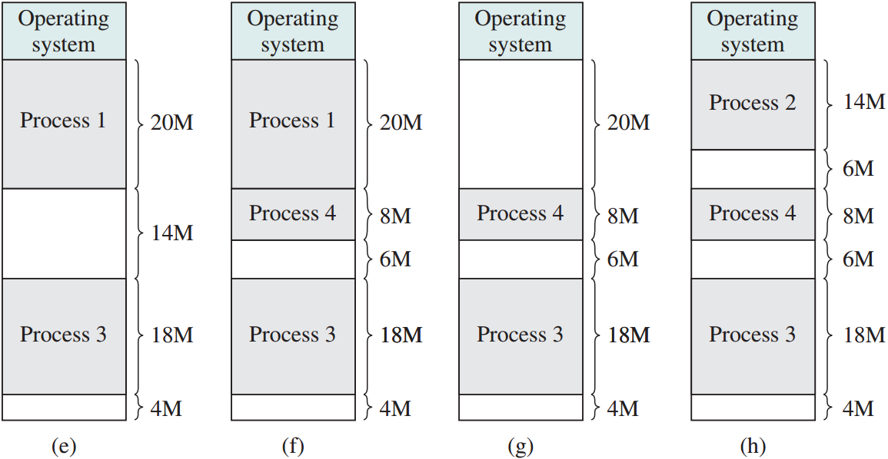
Dynamic Partitioning

Slide 20
Dynamic Partitioning
Memory becomes more and more fragmented – external fragmentation
Memory utilization declines
To overcome external fragmentation – compaction
Shifts the processes so that they are contiguous
Free memory in one block
Time consuming and wastes CPU time

Slide 21
Dynamic Partitioning Placement Algorithm
Operating system must decide which free block to allocate to a process
Three algorithms:
Best-fit
First-fit
Next-fit

Slide 22
Dynamic Partitioning Placement Algorithm
Best-fit algorithm
Chooses the block that is closest in size to the request
Worst performer overall
Since smallest block is found for process, the smallest amount of fragmentation is left
Memory compaction must be done more often

Slide 23
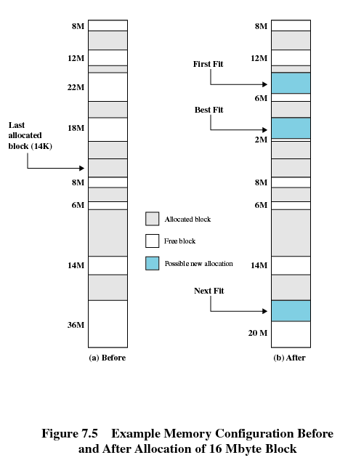
Dynamic Partitioning Placement Algorithm

Slide 24
Dynamic Partitioning Placement Algorithm
First-fit algorithm
Scans memory from the beginning and chooses the first available block that is large enough
Simplest and fastest
May have many process loaded in the front end of memory, litter with small free partitions that must be searched over when trying to find a free block

Slide 25
Dynamic Partitioning Placement Algorithm

Slide 26
Dynamic Partitioning Placement Algorithm
Next-fit
Scans memory from the location of the last placement
More often allocate a block of memory at the end of memory where the largest block is found
The largest block of memory is broken up into smaller blocks
Compaction is required to obtain a large block at the end of memory

Slide 27
Dynamic Partitioning Placement Algorithm

Slide 28
Memory Partitioning
Techniques | Description | Strengths | Weaknesses
Fixed Partitioning | Main memory is divided into a number of static partitions at system generation time. A process may be loaded into a partition of equal or greater size. | Simple to implement, little operating system overhead. | Inefficient use of memory due to internal fragmentation, maximum number of active processes is fixed.
Dynamic Partitioning | Partitions are created dynamically, so that each process is loaded into a partition of exactly the same size as that process. | No internal fragmentation, more efficient use of main memory. | Inefficient use of processor due to the need for compaction to counter external fragmentation.

Slide 29
Buddy System
Memory blocks are available of size 2^{K}, L ≤ K ≤ U
2^{L} = smallest size block
2^{U} = largest size block, generally is the entire memory available
Entire space available is treated as a single block of 2^{U}

Slide 30
Buddy System
If a request of size s such that 2^{U-1} < s <= 2^{U}, entire block is allocated
Otherwise block is split into two equal buddies
Process continues until smallest block greater than or equal to s is generated

Slide 31
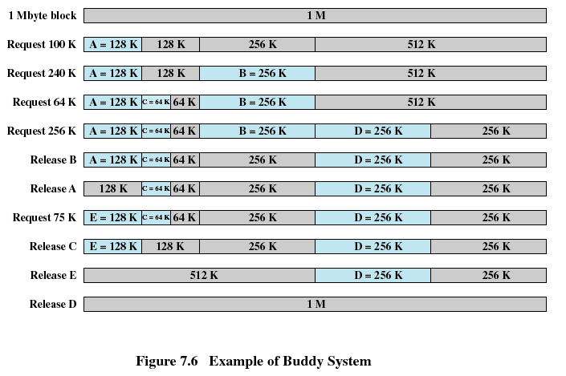
Buddy System

Slide 32
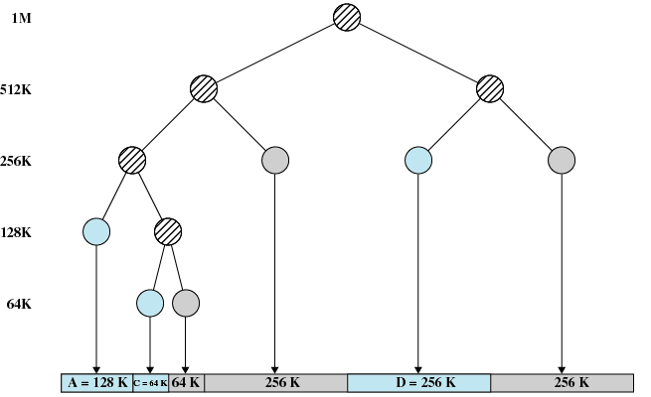
Buddy System

Slide 33
Relocation
When program loaded into memory the actual (absolute) memory locations are determined
A process may occupy different partitions which means different absolute memory locations during execution (from swapping)
Compaction will also cause a program to occupy a different partition which means different absolute memory locations

Slide 34
Relocation: Types of Addresses
Logical
Reference to a memory location independent of the current assignment of data to memory
Translation must be made to the physical address
Relative (example of logical address)
Address expressed as a location relative to some known point

Slide 35
Relocation: Types of Addresses
Physical
The absolute address or actual location in main memory

Slide 36
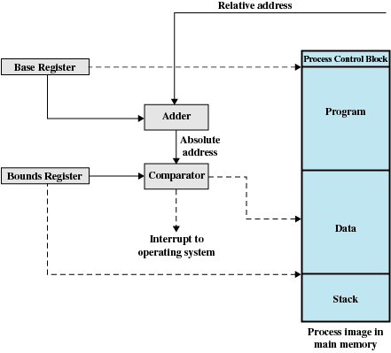
Relocation: Types of Addresses

Slide 37
Registers Used during Execution
Base register
Starting address for the process
Bounds register
Ending location of the process
These values are set when the process is loaded or when the process is swapped in

Slide 38
Registers Used during Execution
The value of the base register is added to a relative address to produce an absolute address
The resulting address is compared with the value in the bounds register
If the address is not within bounds, an interrupt is generated to the operating system

